Slide 1


A model of a recommendation system to enhance research collaboration
TICAL 2019, Sept 3/2019 - Cancún (México)
Fernando Barraza
Jose Luis Jurado

Slide 2
Content
Motivation
Problem background
Project plan
Model design
Evaluation
Deployment
Future work

Slide 3
Motivation
Low usage of collaborative platforms by researchers in LATAM (Archila et al)
Lots of data in institutional repositories and non-structured formats (i.e. excel, word, pdf files)
New coming initiatives to share research projects: Mendeley, ResearchGate.com, IEEE Collabratec ™, Vivoweb.org, OSF, and many others.

Slide 4
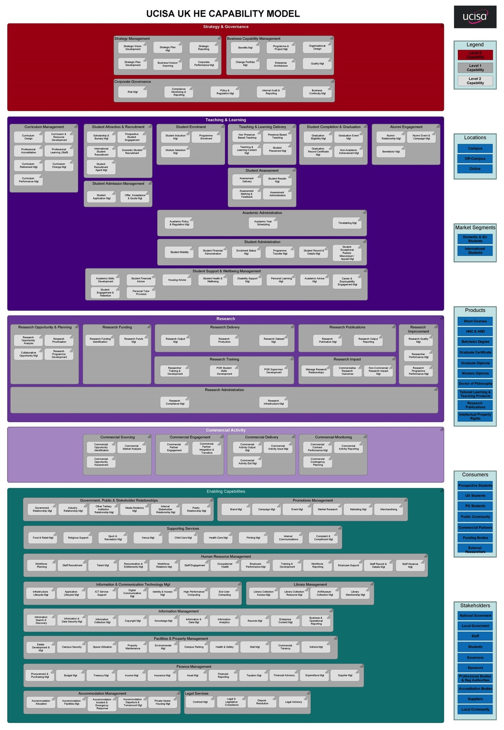
Background: CMM for HE in UK
Collaborative Opportunity Mgt

Slide 5
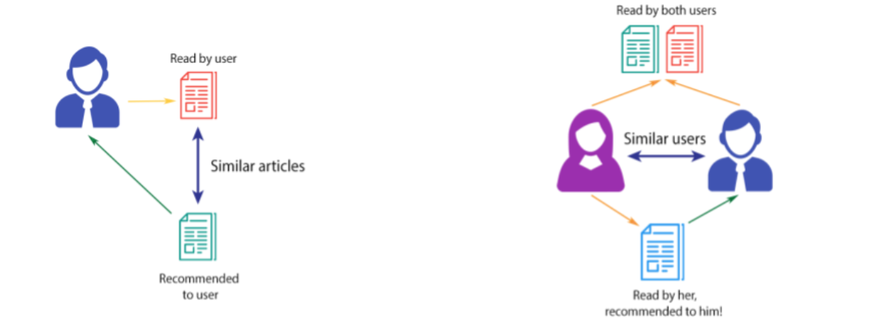
Background: Recommendation Systems
Make a list of items that are more interest of a user
Most known example: Netflix.
Collaborative Filter
Content-Based

Slide 6
Project definition: Goals and requirements
A RS that responds to these questions:
  Who are the most similar researchers to me?
  What projects should I take a look at?
  Who researchers could be peer-reviewers for one of my projects?
A Cloud-based deployment

Slide 7
Project definition: Plan (in a ML cycle)
Define Goals
Identify Data Sources
Model Design
Clean and Prepare Data
Deployment
& Monitoring
Model Training
Evaluation
Testing

Slide 8
Identify Data Sources, Clean and Prepare
Relational Database with about 10k research projects (sapienxis.com)
Clean and Prepare:
  Anonymize user identities and projects contents
  “Stop Words” removing
  Data Normalization (Stemming)

Slide 9
Design of the RS model
Define similitude between projects:
Cosine similarity of two projects documents
Each vector represent a project that has a magnitude of each word count present in the text of the project document (tf-idf).
Formally,

Slide 10
Design of the RS model
Calculate how similar are all projects of a researcher r with a single project x that belongs to other researcher q.

Slide 11
Design of the RS model
We can now built a training dataset that looks like:

Slide 12
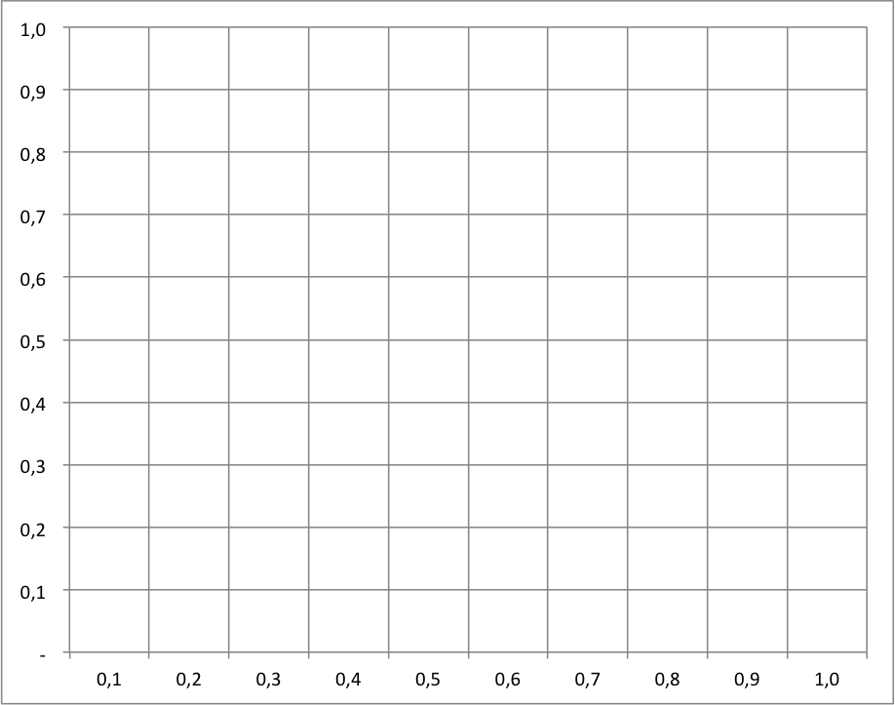
Finding similar researchers
We choose a Euclidean distance metric for similarity between researchers based on their projects.
The closer two researchers are in the project score space, the more similar they are:
Luis
Ana
Pedro
d(r,p_{y})
Juan
Martha
p_{x}=6
p_{y}=7
d(r,p_{x})

Slide 13
Euclidean Distance Calculation
Let r₁ the researcher named Ana and r₂ the researcher named Juan then the similarity score S between them for the projects 6 and 7 is calculated by,
We can only look at two projects similarity at a time, but we can calculate the similarity score of one researcher with every one of others and then sort them to get the k topmost ranked between all the researchers.

Slide 14
Building the ranking for similar researchers
We use this function for a specific researcher,
where r₁ is Ana, j=1 until total of researchers and k is how many recommendations that we want to get.
Luis
k=3
k=2
k=1
Ana
Pedro
Juan
Martha

Slide 15
Finding Projects of interest for a researcher
First approach: We can just look at the person who is most similar to him or her and look between his projects.
Luis
Juan’s projects:
k=3
Project ID (i) | d(r₁,p_{i})
6 | 0.8755
545 | 0.4563
88 | 0.2212
k=2
k=1
Ana
Juan
Martha
But, this approach could return projects that have a low similarity score for the researcher that we want to give a recommendation.

Slide 16
Finding Projects of interest for a researcher
To solve the previous issue, we need to score the projects by producing a weighted score that ranks the researchers.
We take the scores of all the other researchers and multiply how similar they are to the objective researcher by the score they gave each project.
For instance, if we want to know which project recommends to Ana We can use the following formula,
where j=1 until total of researchers, n=1 until total of projects and k is how many projects to obtain.

Slide 17
Recommending Peer-Reviewers
The idea for this recommendation is to give the k names of researchers that could be the peer-reviewers for a objective project.
To solve this one, we use a similar approach to the previous recommendation.
We produce a weighted score that ranks the projects.
We take the similarity score between each project and the objective project and multiply by the score given for all other researchers to every project.

Slide 18
Recommending Peers for Ana’s project
Following with the Ana’s example, if we can give recommendations for the project with id equals to 6 we can use this,
where j=1 until total of researchers, n=1 until total of projects and k is how many peer-reviewers to obtain.
Actually we need to skip Ana in the count of j because if not, she will obviously ranked the first.

Slide 19
Utility-based ranking metric evaluation
We evaluate how well the ranking of items was metric built.
In some cases the item will be the projects, in others the researchers. The formula is:
where i_{j} is the item in the jth position, r_{ui} is user u’s similarity of item i, d is a task dependent neutral rating, and α is a parameter to control how fast decline the value of positions in the ranked list.

Slide 20
Evaluation Results
Test Set | Number of Items | Use Case | Precision
A | 500 | 1 | 0.77
B | 5000 | 1 | 0.83
A | 500 | 2 | 0.70
B | 5000 | 2 | 0.75
A | 500 | 3 | 0.49
B | 5000 | 3 | 0.55

Slide 21
Deployment
Taken from AWS

Slide 22
Conclusions and future work
We have presented a design of RS for a research’s platform that give recommendations on similar researchers, projects of interest and possible peer-reviewers.
We have showed the model behind the RS, how to build the training set and the formulas behind the ML recommendations algorithms.
Also, we present a initial metric for the RS evaluation taking into account the utility of the recommendations for the platform’s users.

Slide 23
Conclusions and future work (2)
Also we expect to enhance the model, the inclusion of others features like project year, institutions involved and so many other information.
At the end, We hope our work contributes to think about the multiple ideas to promote collaboration between researchers.

Slide 24
Thanks!
Questions?

