Slide 1






UnaCloud
Ejecutando Aplicaciones HPC en las Salas de Computadores de la Universidad

Slide 2
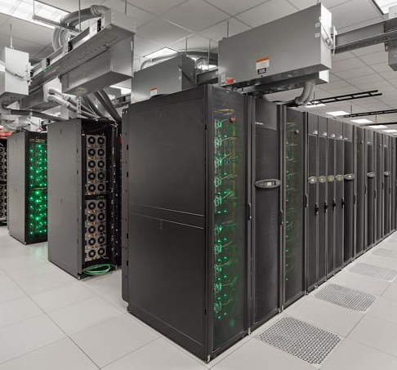
Not all can afford HPC
Facilities for High Performance Computing are expensive.
Many organizations (e.g. small universities) cannot afford them
Stampede supercomputer
University of Texas, USA
Notes:
Image: https://news.utexas.edu/2013/03/27/texas-unleashes-stampede-for-science

Slide 3
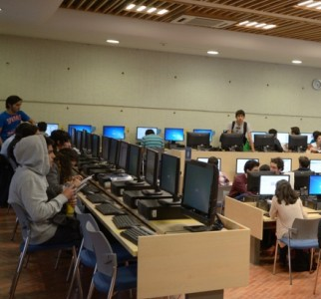
Although they have computer labs,
Not all can afford HPC
However, almost all the universities have computer labs where students may practice and attend classes
These computers may remain idle for
many hours a day.
Computer Lab
Universidad de los Andes, Colombia
Notes:
Image: https://faciso.uniandes.edu.co/index.php?option=com_content&view=article&id=23&Itemid=502

Slide 4

These Computers are idle many hours
For instance, in one of our computer labs:
CPU usage
  In average, it is among 1 to 7%
  Many times, it is < 3%
Memory usage
  It is among 20 to 29%
  Most time, it is <25%
Unused capacity
  24GFLOPS / machine
Gómez C.E., Díaz C.O., Forero C.A., Rosales E., Castro H. (2015)
Determining the Real Capacity of a Desktop Cloud In CARLA 2015. Springer. 2015

Slide 5
Can we use these unused resources to run HPC / MPI applications?
Yes. Using UnaCloud

Slide 6
UnaCloud
Our implementation of an Opportunistic Cloud Computing Platform
It allows scientists and researchers
  Create/access virtual clusters
  Create/access virtual machines
Using idle resources in the computers of the university labs
  More than 1 VM per PM

Slide 7





UnaCloud
How it Works?
❶ We configure virtual machines with the applications to use
  VM images
❷ Define the specs for the clusters
  HW profiles
  Clusters
VM Images
Cluster definition

Slide 8
UnaCloud
How it Works?
❸ On request, UnaCloud deploys the clusters on computers in the labs
An agent installed in each computer in the lab configures and starts the virtual machines

Slide 9
UnaCloud
How it Works?
Virtual machines and clusters may run beside other applications started by the users in the desktop
Each Campus Desktop
VM
Guest OS
UnaCloud Agent
VM Hypervisor

Slide 10

UnaCloud
How it Works?
Unacloud must deal with failures possibly caused by the users in the desktops
Turned-off machines
Reboot
Killed processes

Slide 11
UnaCloud
How it Works?
Unacloud supports two types of nodes
Opportunistic nodes (shared with users)
High-availability nodes (on dedicated HW)

Slide 12
UnaCloud
How it Works?
We are running UnaCloud on four (4) computer labs
Lab | # of machines
Waira 1 | 48 machines
Waira 2 | 30 machines
Turing | 39 machines w/ GPUs
Redes Lab | 9 machines

Slide 13
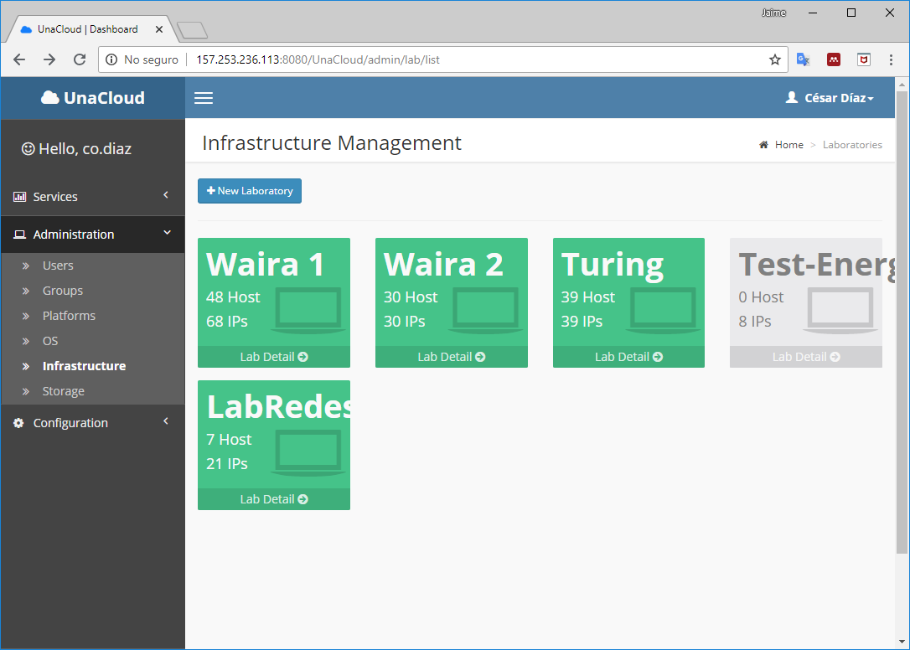
UnaCloud
How it Works?
Users and Administrators use a web-based user interface to configure and control the virtual machines and clusters

Slide 14
UnaCloud
Pros:
  Can exploit computation resources not used by the users in the computer labs
  Can run scientific workflows and applications using low-cost infrastructure
Cons:
  Users using the computers may restart or turn-off the computers
  Computers are bought for such users
  Communications are not as fast as on real cluster

Slide 15
UnaCloud vs. other similar solutions
UnaCloud is an opportunistic platform for virtual clusters (instead of bag of tasks)
  It does not package a job, send it to the machine neither collect the results.
  Support diverse types of computing styles, including MPI and other types of clusters
  Researchers can build their own virtual machines installed any software of interest.
It is focused on exploiting unused computing power by running virtual machines and clusters not on performance

Slide 16
How HPC/MPI run on UnaCloud?
e.g., GROMACS

Slide 17
UnaCloud
Running MPI applications
We have run diverse MPI applications on UnaCloud
  Gromacs MPI
  MPI-based R applications
  MPI-based Ray Tracing applications
  Custom MPI-applications for data mining and cryptography
Bohorquez E., Rosales E., Castro H. (2015)
Running MPI Applications over Opportunistic Infrastructure In CCISIS 2015.
Garcés Ferrera N., Sotelo G., Villamizar M, Castro H. (2012)
Running MPI Applications over Opportunistic Cloud Infrastructures In 3PGCIC 2012.
Ortiz N., Garcés Ferrera N., Sotelo G., Méndez D., Castillo-Coy F. H., Castro H. (2012)
Multiple Services hosted in the opportunistic Infrastructure UnaCloud
In Joint GISELA-CHAIN Conference. 2012

Slide 18
UnaCloud
Running Gromacs MPI
One of our initial implementations was GROMACS MPI
  We used UnaCloud to predict the Helicobacter Pylori CagA protein 3D structure, exploring 30 temperatures between 350 and 400K
Scenario | # cores | Execution time
15 VMs x 1 core | 15 cores | 6.63h
30 VMs x 1 core | 30 cores | 3.67h
30 VMs x 2 cores | 60 cores | 3.27h
Garcés Ferrera N., Castro H., Delgado P., González A., Jaramillo C., Peñaranda N. Delgado M.
Analysis of Gromacs MPI using the Opportunistic Cloud Infrastructure UnaCloud. CISIS 2012

Slide 19
UnaCloud
Running Gromacs MPI
At 2012, we detected high probabilities of failures
  MPI tasks fail when one node fails or is stopped
  A node may fail because the intervention of the users
It is necessary to integrate fault-tolerance techniques !!
Scenario | # cores | Execution time
15 VMs x 1 core | 15 cores | 6.63h
30 VMs x 1 core | 30 cores | 3.67h
30 VMs x 2 cores | 60 cores | 3.27h
Failure Probability
58.0%
81.5%
81.5%
Garcés Ferrera N., Castro H., Delgado P., González A., Jaramillo C., Peñaranda N. Delgado M.
Analysis of Gromacs MPI using the Opportunistic Cloud Infrastructure UnaCloud. CISIS 2012

Slide 20
UnaCloud
Running MPI applications
We have been implementing several fault-tolerance techniques to start and run GROMACS and MPI jobs
2012: Fault tolerance for Gromacs MPI
- Determine nodes and configure MDP daemons at startup.
- To save (checkpoint) the state of the jobs periodically
- To run and restart the execution of the GROMACS simulations
2015: Fault tolerance for MPI applications
- library-based MPI snapshots
2017-today: Fault tolerance for non-MPI applications
- Design for relaibiity
Garcés Ferrera N., Castro H., Delgado P., González A., Jaramillo C., Peñaranda N. Delgado M.
Analysis of Gromacs MPI using the Opportunistic Cloud Infrastructure UnaCloud. CISIS 2012

Slide 21
UnaCloud
Understanding the problem
Efficient file transmission protocols
M₁
Reduce the size of the files to be transmitted
Network congestion
M₂
f₁
Reduce the need to transmit files
¿ Why don't virtual machines always start running?
Insufficient hard disk space
M₃
x
f₂
Efficiently manage
disk space
Virtual image is incompatible
M₄
f₃
Location algorithms that consider disk space
The virtual machine does not log in
M₅
f₄
Preconfigured
virtual images
M₆

Slide 22

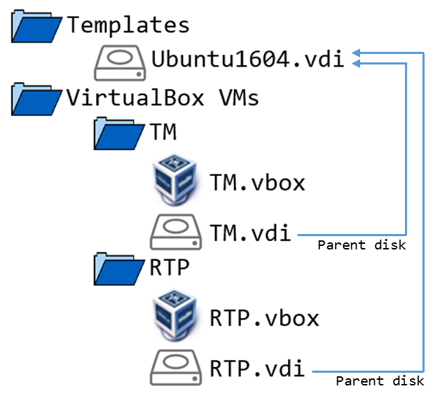
UnaCloud
A new model
Closed catalog of Images
Pre-loaded images
Multi-attach disks
  Fast cloning and booting
  Enables migration
Global snapshot
Packet coloring
Packet filtering

Slide 23
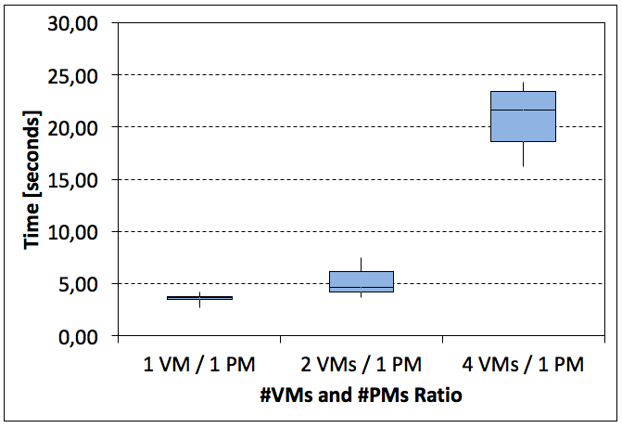
UnaCloud
Some results
More than 400 VM deployed in less than 3 minutes
Applications may resume their execution at any time
We can pause/resume applications
We can restart from any checkpoint

Slide 24
Some conclusions…
Ideas to take-away

Slide 25
UnaCloud
UnaCloud is an Opportunistic Platform that may run HPC and MPI applications
  Use idle resources in the computers of university labs
  Support customized virtual clusters and machines
  May integrate fault-tolerance techniques to support long jobs
  Great training tool
UnaCloud is flexible enough to integrate high-availability (dedicated) nodes and external clusters
We have run successfully several HPC/MPI applications
  GROMACS MPI, MPI-based data-mining, MPI-based render, …
UnaCloud may offer computing power for data analysis and simulation when dedicated HPC infrastructure is not available
  Choosing the right application is important

Slide 26
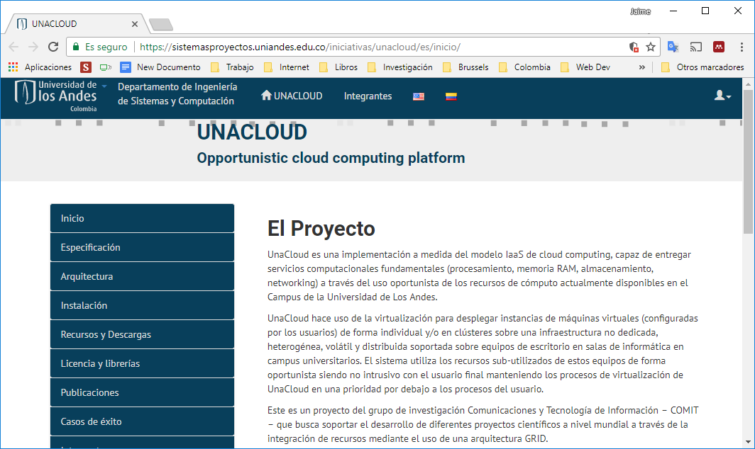
UnaCloud
More information
https://sistemasproyectos.uniandes.edu.co/iniciativas/unacloud/es/inicio/

Slide 27
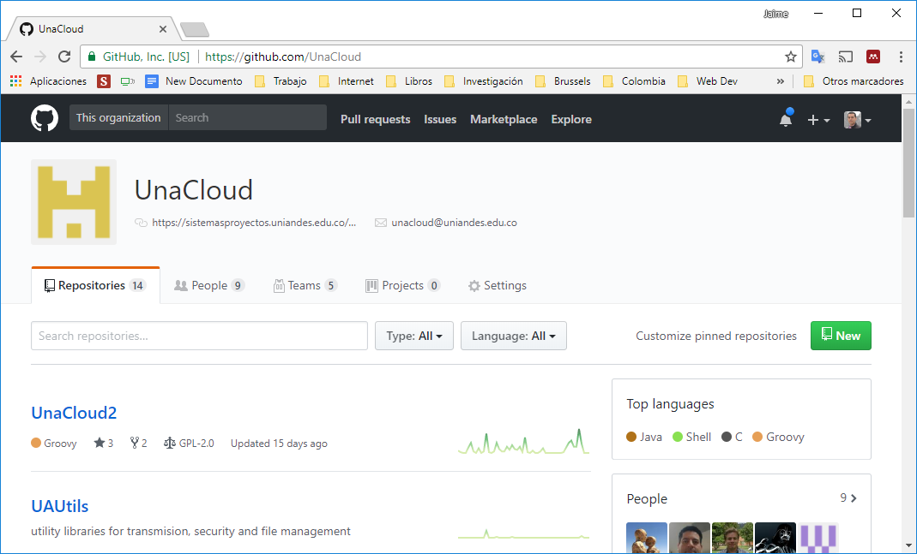
UnaCloud
More information
https://github.com/UnaCloud

Slide 28
UnaCloud
Questions?
Harold Castro
hcastro@uniandes.edu.co

